Slide 1
Healthy Meals Restaurant in Tempe, AZ
Walaa
Notes:
NOTE:
To change the image on this slide, select the picture and delete it. Then click the Pictures icon in the placeholder to insert your own image.

Slide 2
Introduction
The two top employers in Tempe, AZ are: Arizona State University and State Farm.
ASU and State Farm are closed enough to think about having a healthy meals center to serve their employees.
This area is poor of healthy restaurants.

Slide 3
Problem Statement
Where is the best place in Tempe to open a healthy meals center which prepare and deliver the meals to the customers?

Slide 4
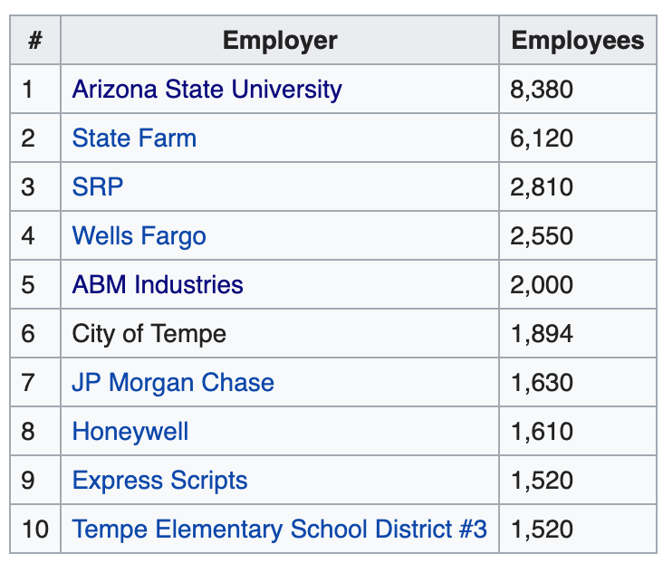
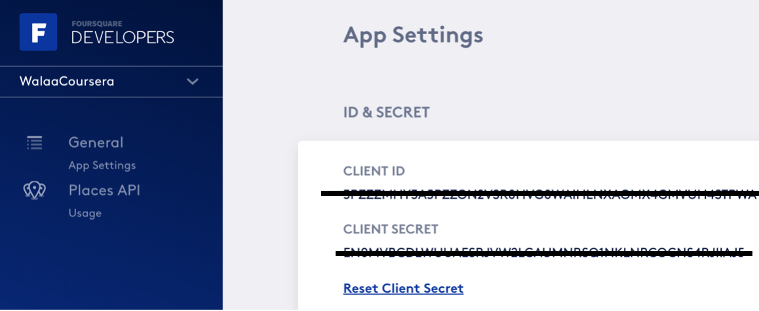
Data
1- Wikipedia page [https://en.wikipedia.org/wiki/Tempe,_Arizona]
2- Foursquare API

Slide 5
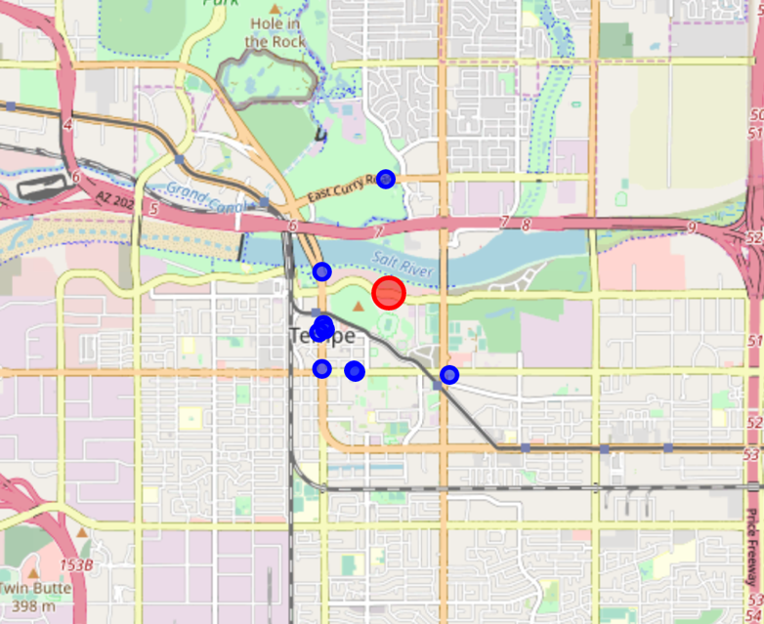
Data
Bellow map shows the
restaurants within 500 meters
around ASU building:

Slide 6
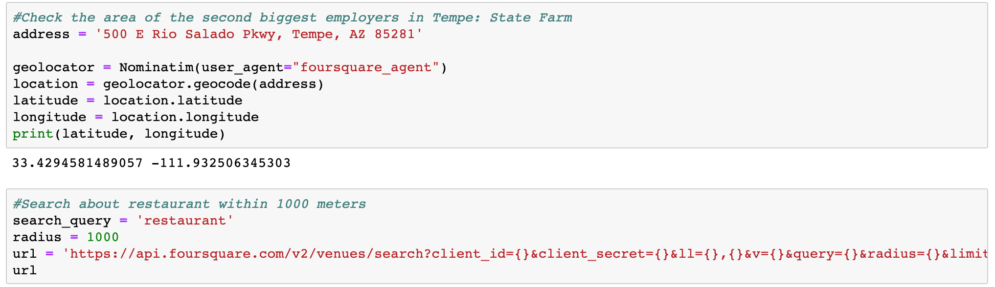
Methodology
Using the geographic data which is requested from the Foursquare helps to understand the
lack of options.

Slide 7
Result
Depending on some geographic calculation, opening in the middle will serve huge number of employees in the area.

Slide 8
The steps to solve this problem
Data
Wikipedia
Foursquare
Methodology
Search
Listing
Result
Deciding

Slide 9
Conclusion
Making a decision about the best location for a new healthy food which will be serve huge number of employees

